Slide 1

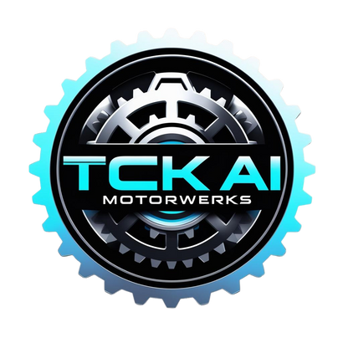
BEGINNER ROADMAP TO GPT-5 ADOPTION
Powered by TCK Worldwide

Slide 2



BEGINNER ROADMAP TO GPT-5
Unlocking AI for Everyday Use
This roadmap breaks down complex AI adoption into a simple, visual guide tailored for beginners, freelancers, and small business owners—making it easier to understand, implement, and benefit from GPT-5 without needing a technical background.

Slide 3
THE NEXT LEAP IN AI
Smarter memory
Better reasoning
GPT-5 will remember details across conversations—like your name, tone preferences, or past projects—making it feel more like a real assistant than a search engine.
GPT-5 will be more capable of understanding complex problems, breaking them down logically, and providing clearer solutions—even with little instruction.
real-world task automation
Instead of just giving ideas, GPT-5 can do things—like draft reports, generate videos, schedule meetings, and even trigger automations using tools like Zapier or Notion.

Slide 4
IS THIS ROADMAP FOR YOU?
This resource is designed to benefit a wide range of individuals and groups, including entrepreneurs who are seeking to innovate and grow their businesses, freelancers who are looking to enhance their skills and manage their projects more effectively, students who aim to expand their knowledge and prepare for future careers, and teams along with managers who strive to improve collaboration and productivity in their workplaces.
NO TECH EXPERIENCE NEEDED

Slide 5

Step 1 – Learn the Basics
Watch 1-2 YouTube explainers
01
Get a quick visual overview of how GPT works
Try GPT-4 in ChatGPT Free or PLUS
02
Experience basic AI conversations firsthand
Learn terms: Prompt, Token, Hallucination
03
Understand key concepts that shape AI output
Compare GPT-3.5 vs GPT-4 vs GPT-5
04
See how each model improves accuracy and memory

Slide 6

Step 2 – Choose Your Tools
Start Simple, Start Smart
Chat GPT
Canva
Zapier
Wix
Why:
Easiest way to start chatting with AI
Why:
Why: Design + AI text = instant social content
Real-time data monitoring
Automated risk detection
roactive risk management
Why:
Build AI-powered websites with ease

Slide 7

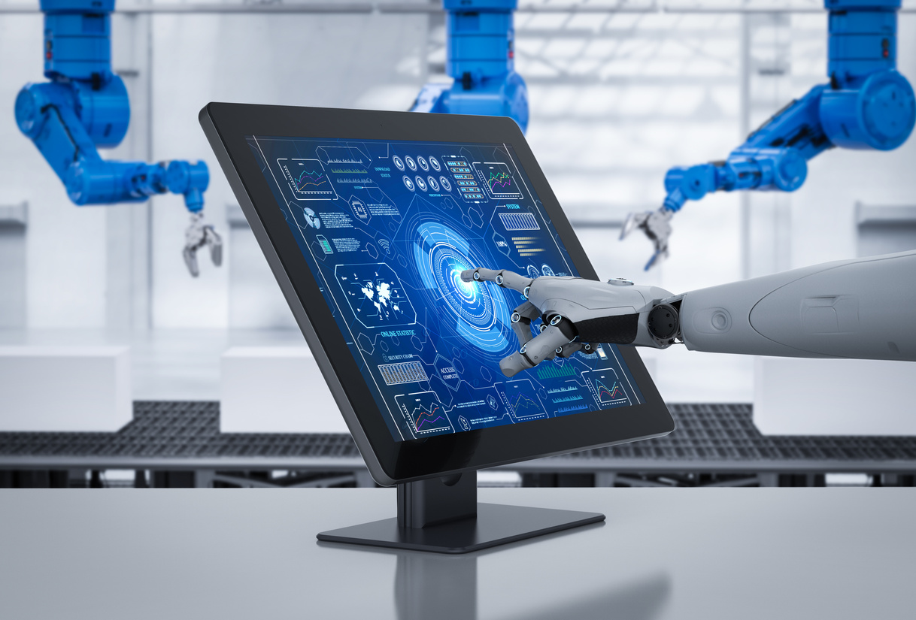
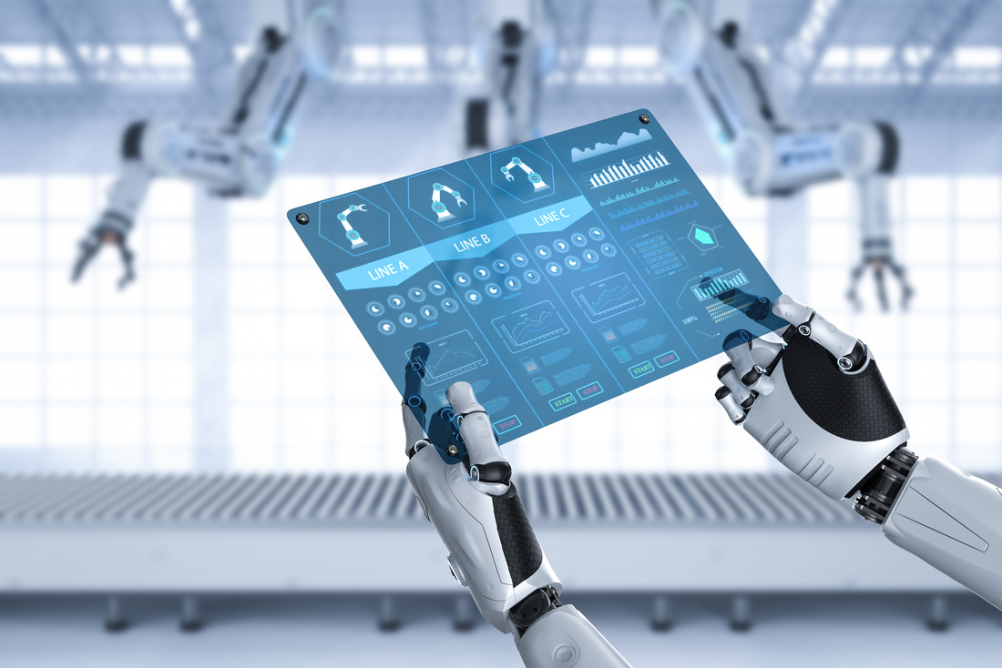

Step 3 – Practice Daily Use Cases
Use It Like a Real Assistant
Write emails or LinkedIn posts
Summarize PDFs or notes
Plan your week or scripts
Brainstorm social or blog ideas
Use GPT to draft professional messages or social updates that match your tone and audience style.
Quickly extract key insights from documents or meeting notes without reading every word.
Let GPT organize your weekly tasks, write agendas, or create content outlines from your notes.
Generate fresh, tailored content ideas for your niche using current trends or past audience data.

Slide 8
Step 4 – Build Your First Workflow
Turn AI Into a Daily Assistant
Blog → Script → Video
Use GPT-5 to turn blog articles into YouTube scripts, then create videos with tools like Pictory.
Why: Streamlines content creation for blogs, video, and social from one source of truth.
Why This Matters
(Expanded):
Google Sheet → Zapier → Email
Connect a spreadsheet to auto-send emails, alerts, or updates with AI-written content.
Why: Saves manual steps in lead follow-ups, reporting, or client check-ins.
CRM → Auto Notes & Responses
Automating just one recurring task with GPT-5 can reclaim hours weekly and give you real leverage.
Use GPT-5 to generate summaries, draft replies, and log entries from client interactions.
Why: Speeds up admin work and improves response time with fewer errors.
Product List → Social Captions
Feed GPT-5 your product descriptions to auto-generate social media captions or hashtags.
Why: Great for solopreneurs or e-commerce brands posting daily content.

Slide 9
1.
Follow OpenAI & TCK Worldwide on LinkedIn
Step 5 – Stay Updated Before Launch
2.
Join Newsletters (e.g., The Supply Line)
3.
Increased use of robotics and automation for warehouse operations
Position yourself now to lead, not follow, when GPT-5 launches. Early adopters will gain the most—whether that means automating faster, creating smarter, or building AI-driven systems before the market catches up. The future won’t wait—prepare now to stay relevant, efficient, and competitive.
4.
Attend Launch Webinars & Demos
5.
Review or Create an AI Use Policy
Why This Matters
Being prepared before GPT-5 launches gives you a strategic edge. You’ll be ready to implement features the moment they drop—while others are still figuring out what changed. This means faster adoption, smarter testing with real use cases, and the ability to lead in your space rather than play catch-up. Early action equals early wins.

Slide 10

Final Thoughts
You Don’t Need to Be an Expert—Just Get Started
Quote:
“Don’t wait to become an expert—start experimenting. GPT-5 will reward doers, not watchers.”
— Trent Creal, Founder, TCK Worldwide
Closing Message:
GPT-5 isn’t just a new tool—it’s a new way of working.
If you take small, consistent steps now, you’ll be ready to unlock its full value the moment it drops.
Call to Action:
Ready to lead, not follow?
👉 Download our free [Prompt Pack for Beginners]
👉 Subscribe to The Supply Line AI newsletter

